Slide 1
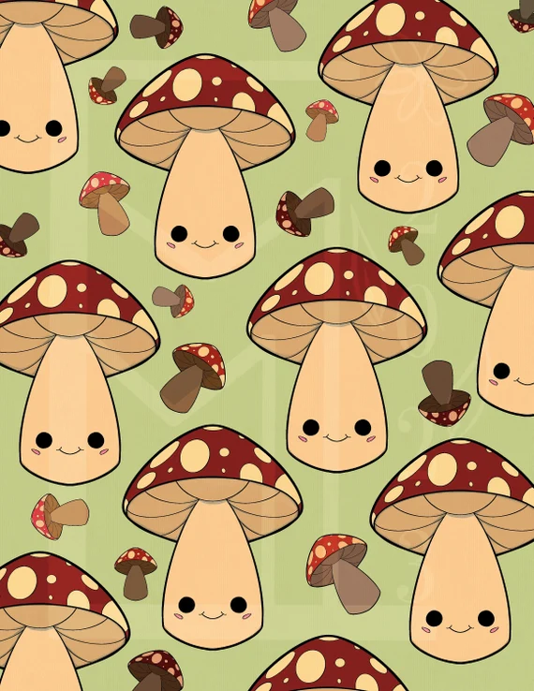
MUSHROOM CLASSIFICATION:
EDIBLE OR POISONOUS
Presented by:
Kevin Linder
Elizabeth Bauer

Slide 2
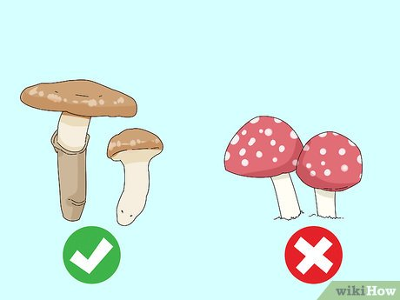
PROJECT OVERVIEW
Objective: train a machine learning model to classify mushrooms as either poisonous or edible.
TECHNOLOGIES USED:
Python
Pandas
SKLearn: Random Forest
SKLearn: K-Nearest Neighbor
Jupyter Notebook
MongoDB/NoSQL

Slide 3
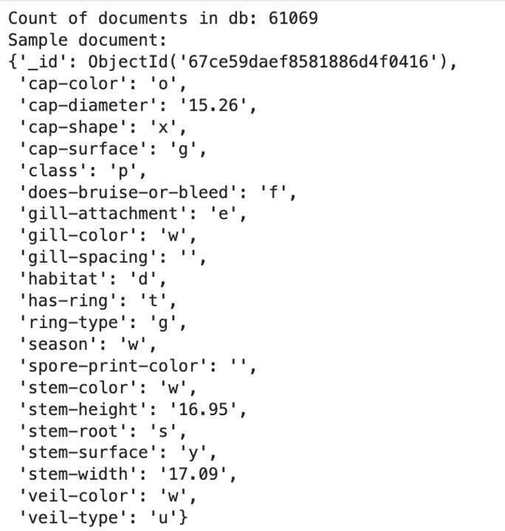
THE DATASET
This analysis uses a dataset of 61,069 rows of simulated mushroom data. This dataset was obtained from UC Irvine’s Machine Learning Repository.
The dataset includes metadata columns such as:
Cap-diameter, cap-shape
Does-bruise-bleed
Gill-attachment, gill-color, gill-spacing, gill-color
Stem-height, stem_width, stem-root, stem-surface, stem-color
Veil-type, veil-color
Has-ring, ring-type
Spore-print-color
Habitat
Seasons

Slide 4
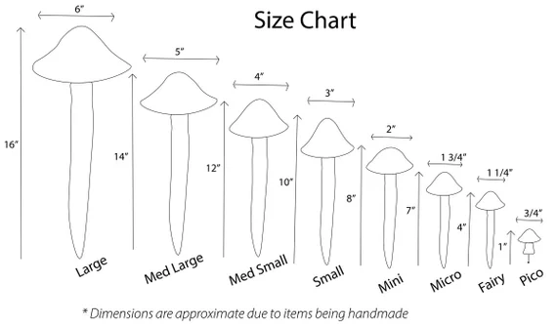
PRE-PROCESSING FOR OPTIMIZATION
ITERATION TWO
Replace empty values with “N/A” as a distinct categorical value in all columns. No columns were dropped.
Create categorical dummies
Scale the data
Result (Random Forest) : 1.0 Accuracy
ITERATION ONE
Drop all columns with empty values
Reduced from 20 to 11 columns
Create categorical dummies
Scale the data
Result (Random Forest) : 0.996 Accuracy

Slide 5
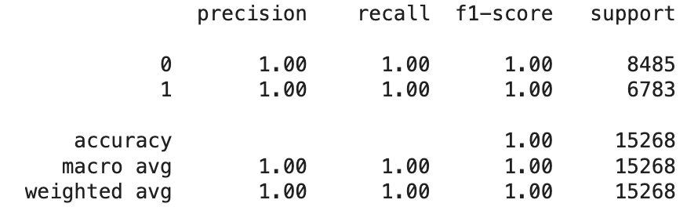
DATA MODEL IMPLEMENTATION
Random Forest Classification
Initial Model Received a 100% Accuracy
Reasons for choosing Random Forest:
Works well when evaluating non-linear relationships in data
Performs well with data that has high dimensionality
Mushrooms live in forests

Slide 6
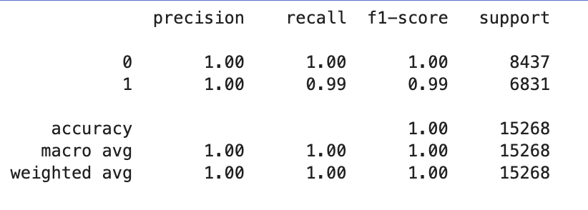
DATA MODEL OPTIMIZATION
K-Nearest Neighbors Model
Initial Model Received a 99.9% Accuracy
Reasons for choosing KNN:
Easy to set up
Strong with multi-dimensional classification problems

Slide 7
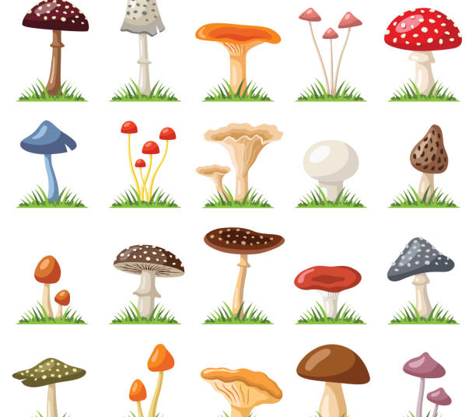
Thanks!
Contact us:
Safe2Eat
123 Morel Way
Your City, ST 12345
no_reply@example.com
www.example.com

